Slide 1
Moderator Guide
TO GET STARTED:
Download our Moderator Guide & Speaker Notes to prepare for your session, find links to necessary materials, and learn what to say.
Notes:
[This slide contains the linked moderator playbook for this virtual workshop and does not need to be presented during your session or contain accompanying speaker notes.]
Link to moderator guide & speaker notes: http://leanin.org/allyship-60minute-playbook

Slide 2
This session is intended to serve as a primer for the full Allyship at Work program. It explores what allyship means and provides a shortlist of steps attendees can take to practice allyship. The full program offers details of 50 research-backed allyship actions that attendees can take. It is run as a half-day, 4-hour workshop (you can also run it in two, 2-hour workshops) and 3 follow up sessions.
If you’re interested in exploring the full program next, be sure to use the following materials:
4-Hour Moderator Guide
4-Hour Workshop Presentation
A note before you get started
Notes:
[This slide contains a note for the moderator and does not need to be presented during your session or contain accompanying speaker notes.]
Link to 4-hour moderator guide: http://leanin.org/allyship-moderator-guide
Link to 4-hour workshop presentation: http://leanin.org/allyship-presentation

Slide 3
Disclaimer:
The contents of the Allyship at Work program and other Lean In materials are for general education purposes only and do not reflect the practices or policies of any one business or organization. The program strives to empower employees to build an inclusive workplace culture, and is not intended as legal advice. The information presented here does not comment on any specific company’s practices, nor does it create any legal obligations on behalf of the company or Lean In.
Notes:
(Optional: Read out disclaimer)
Before we get started, I have a disclaimer I’d like to share. The content we will cover today is from Lean In’s Allyship at Work program.
The contents of the Allyship at Work program and other Lean In materials are for general education purposes only and do not reflect the practices or policies of any one business or organization. The program strives to empower employees to build an inclusive workplace culture, and is not intended as legal advice. The information presented here does not comment on any specific company’s practices, nor does it create any legal obligations on behalf of the company or Lean In.

Slide 4
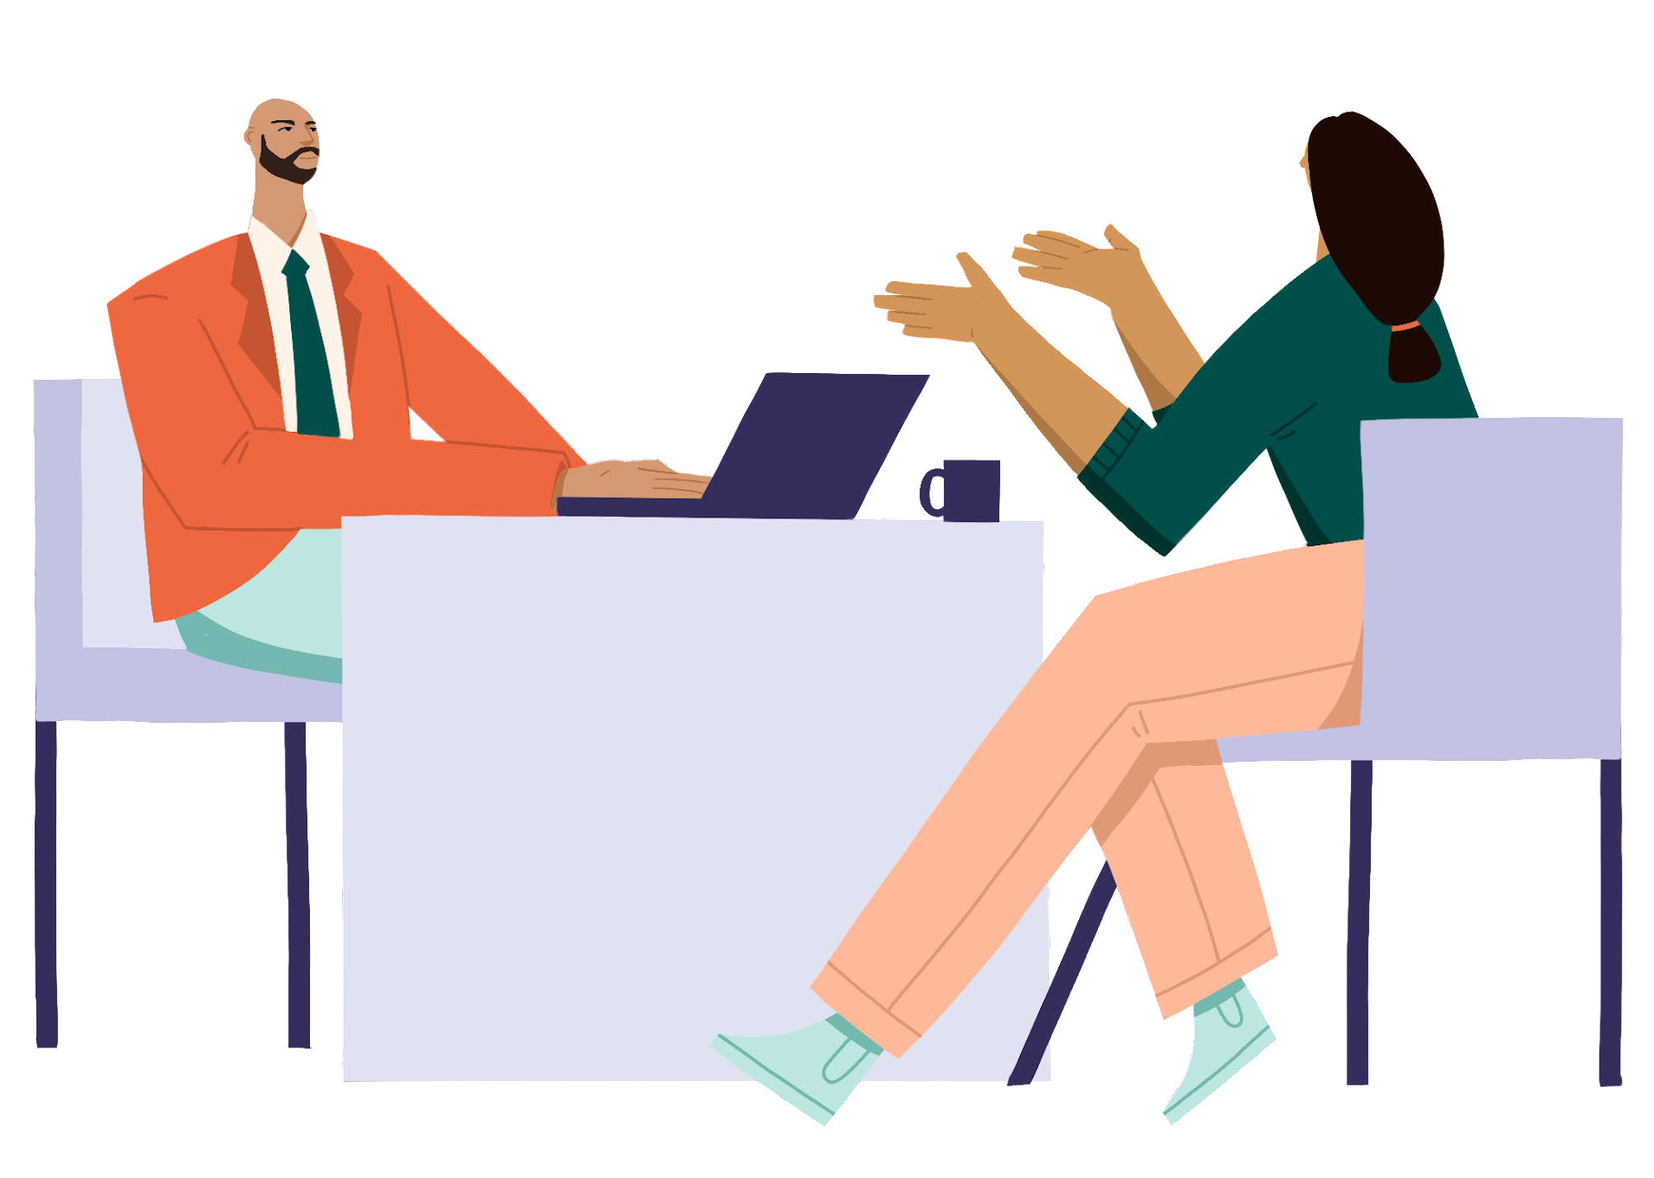
Introduction to
1-HOUR WORKSHOP
Notes:
Before you share your screen:
Hello everyone! My name is [INSERT NAME], I use [INSERT PRONOUNS], and I’ll be facilitating this program at [INSERT COMPANY]
MODERATOR PERSONALIZATIONS:
Provide context on this program for your employees – telling them why this is an important program for your company. Consider sharing the following:
Why are you motivated to bring this to your organization?
Where is the company on your allyship journey? How does this fit into, or differ from, other allyship efforts?
Why is this program important to your organization?
------------------------------------------------------------
With that, let’s dive in.
[Share screen]
Welcome to the Introduction to Allyship at Work!

Slide 5
Note:
This session is intended to serve as a primer for the full Allyship at Work program. It explores what allyship means and provides a shortlist of steps attendees can take to practice allyship.
The full program offers details of 50 research-backed allyship actions that attendees can take. It is run as a half-day, 4-hour workshop (you can also run it in two, 2-hour workshops) and 3 follow up sessions.
Notes:
Allyship at Work is a program created by Lean In. This session is intended to serve as a primer for Lean In’s full Allyship at Work program. It explores what allyship means and provides a shortlist of steps attendees can take to practice allyship.
The full program goes more in depth and offers 50 research-backed allyship actions that attendees can take. It is run as a half-day, 4-hour workshop (you can also run it in two, 2-hour workshops) and 3 follow up sessions.

Slide 6
Welcome!
Remove distractions
Get comfortable
Find a space where you can talk openly
Ground yourself
©2021 LeanIn.Org, LLC 6
Notes:
With that being said, we’re so glad you’re here. During our time together, we invite you to:
Remove distractions—pause notifications on your phone and computer
Get comfortable—take a moment to get water, some note-taking things, and anything you need to be prepared for this time together
Find a space where you can talk openly—we’ll be in small group discussions throughout the workshop
Ground yourself—take a breath, and do what you need to do to feel present

Slide 7
1
2
3
4
5
6
Define allyship
Unpack your privilege
Understand workplace inequities
Agenda
Discover power
Discover allyship actions
Wrap Up
©2021 LeanIn.Org, LLC 7
Notes:
Today we will cover some of the concepts in the full Allyship at Work program but given that this is a 60-minute session, we will not cover all of the strategies, frameworks, or researched-backed solutions provided in the full program.
For this workshop, we’re going to focus on developing a shared understanding of allyship. So we’ll learn about:
What allyship is—and isn’t
Unpacking our personal privilege in and outside of work
Learning about the inequities that impact people with less privilege at work
Discovering our power and a shortlist of allyship strategies
This program does not end in this workshop, we encourage you to continue on to the full program to explore additional allyship strategies and build your own Active Allyship Framework.

Slide 8
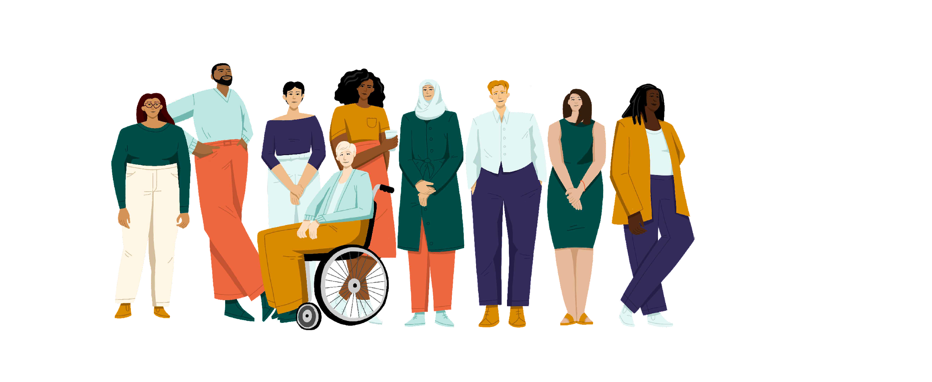
WHY I’M HERE
©2021 LeanIn.Org, LLC 8
Notes:
An important part of allyship is doing the work to understand our privileges, our intentions, and our role in any given situation. So before we begin, I want to talk about why I'm facilitating the session today.
[Share your personal allyship introduction]
[MODERATOR PERSONALIZATION: Create your own allyship introduction
When doing your allyship introduction, we encourage you to share: why allyship matters to you and why you’re moderating this program
This is important modeling and stage setting early in the program. If you present as someone with privilege, it’s important to own why you’re facilitating
For example, if you’re white, straight, cis, or any gender, you might say something like this:
“I want to be explicit in why I'm moderating this -- allyship is everyone's work, and it's largely the work of people with privilege to support and advance those with less privilege. As a white, straight, cis woman, it's critical that my allyship is informed by the groups that I aim to support – and we’ll talk about this throughout the program. But it’s also important that I do the work myself so that the burden of promoting equity doesn't fall on those with less privilege, as it often tends to.”

Slide 9
Allyship can be a powerful force for good
Allies help people with traditionally marginalized identities feel supported and included
Other employees step up
Culture shifts to promote equity
©2021 LeanIn.Org, LLC 9
Notes:
Most of us probably understand that acting as an ally is important in making people with traditionally marginalized identities feel included and supported.
But it’s not just about our individual actions: Research shows allies don’t just influence one person at a time. They inspire others to act as change agents, too, creating a culture of acceptance and support.
Simply put, allyship is a powerful force for good.

Slide 10
Employees with traditionally marginalized identities are not getting the allyship they deserve
63%
16%
11%
WHITE
LATINAS
BLACK WOMEN
White employees that see themselves as allies to women of color
Employees that think employees of their race and gender have allies at work
LeanIn.Org and McKinsey & Company, Women in the Workplace 2020 (September 2020), https://womenintheworkplace.com
©2021 LeanIn.Org, LLC 10
Notes:
The problem is that too few employees with traditionally marginalized identities are getting the allyship they deserve.
For example, only 16 percent of Latinas report that they have strong allies in their organization, and Black women are even less optimistic about the level of allyship they receive.

Slide 11
There’s a gap between intent and action
White employees . . .
77%
63%
45%
43%
39%
2020
2021
ALLYSHIP ACTIONS
21%
10%
See themselves as allies to women of color
Educate themselves about the experiences of women of color
Publicly give credit to women of color for their ideas
Work to confront discrimination when they see it
Advocate for new opportunities for women of color
Are mentoring women of color
LeanIn.Org and McKinsey & Company, Women in the Workplace 2020 and 2021
©2021 LeanIn.Org, LLC 11
Notes:
Part of the reason for this is there’s a gap between our good intentions and the actions we take.
While a majority of employees think of themselves as allies, relatively few white employees are performing basic allyship actions, such as advocating for racial equity or mentoring women of color.
Over the past years, with renewed commitments to allyship, even more white employees see themselves as allies. But, the 2021 data shows that white employees still aren’t taking these basic allyship actions.

Slide 12
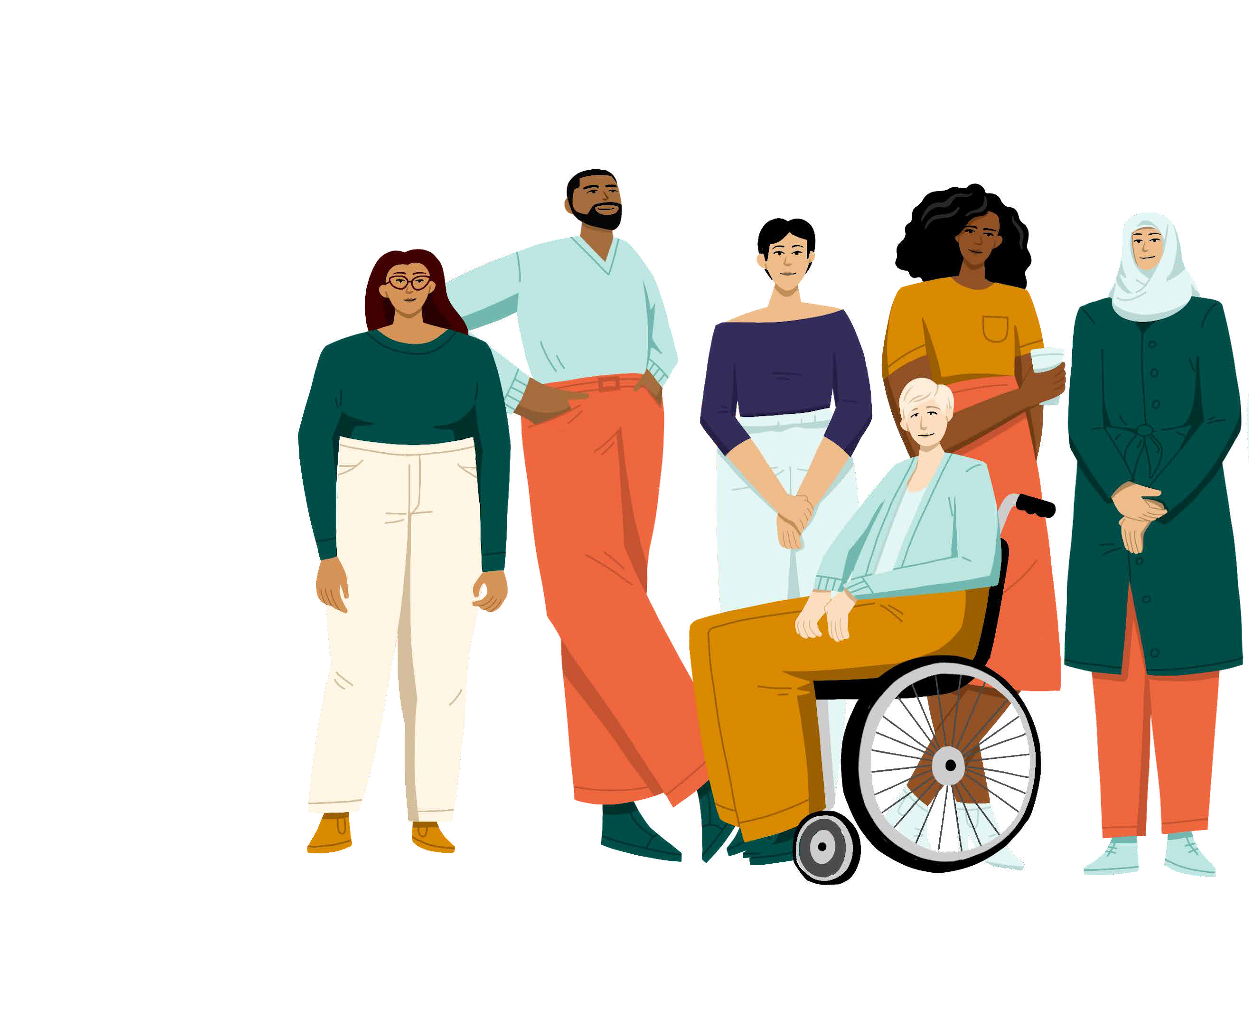
How to be an ally at work to people with a broad range of traditionally marginalized identities
Centered on the experiences of:
The LGBTQ+ community
People with disabilities
People of color
Women
Built in partnership with experts and those with lived experiences
©2021 LeanIn.Org, LLC 12
Notes:
The full Allyship at Work program is a 4-hour, half day workshop and 3 follow up sessions that works to bridge the gap between intent and action by teaching employees to recognize their privilege and power to create change. It also introduces more than 50 research-backed actions you can take to show up as allies.
Today’s session will serve as an introduction to the full program and will focus on individual explorations, real-life stories, group discussions, and videos to help us develop a shared understanding of allyship and uncover how privilege impacts our experience. The goal for today is that you walk away excited and energized to continue your allyship journey.
This program takes a broad look at how to be an ally at work to people with a wide range of traditionally marginalized identities – and we recognize that looks different for everyone, because no two people are the same.
The program focuses on the experiences and needs of the LGBTQ+ community, people with disabilities, people of color, women, and people with intersecting, traditionally marginalized identities, and will also explore issues of religion and class.
There may be identities or experiences that aren’t covered in this programming – it is not intended to be exhaustive. It’s meant to be a starting point for your allyship journey so you can learn how best to support your colleagues with traditionally marginalized identities.
It’s important to note here that this program was built in partnership with people with those identities – because true allyship centers the voices of those impacted by inequities.
Contributors included people with lived experiences as well as subject matter experts like academics who study privilege, and leaders in workplace equity. You’ll hear audio stories from them directly sprinkled throughout the program.

Slide 13
A FEW NOTES
You will need a pen + paper or somewhere to journal
Message me with any questions or issues that arise during the session or in breakout groups
©2021 LeanIn.Org, LLC 13
Notes:
You will do individual reflections and respond to journal prompts today. You’ll want to grab a pen and paper, word doc on your computer, or however you’d like to track your responses.
Finally, feel free to send me a private message if you run into an issue at any point during this workshop that you’d like me to be aware of. I’ll also be cycling through the breakout discussions to see how they’re going.

Slide 14
Define Allyship
©2021 LeanIn.Org, LLC 14
Notes:
Let’s get into it!

Slide 15
JOURNAL EXERCISE
What does allyship look like to you? What is it not?
What do you think would make you a stronger ally? What’s preventing that?
©2021 LeanIn.Org, LLC 15
Notes:
We’re going to start with a journaling exercise. So grab a pen and paper or pull up a word doc where you’ll want to log your responses from today. I want you to take one minute and journal:
What does allyship look like to you? What is it not?
What do you think would make you a stronger ally?
What’s preventing that?
Go ahead and begin journaling, feel free to turn your cameras off. I will give you one minute, then turn your cameras back on when you’re done to join us back here.
[Set timer for 1 minute]

Slide 16
©2021 LeanIn.Org, LLC 16
Notes:
Thank you for taking the time to start reflecting. Now, we’ll watch a short video about what allyship is and why it’s important.
As you watch it, think about how this definition differs from yours or how it’s similar.
Then we’ll move into breakout groups to talk about this more.
[Play video and make sure you stay off mute to ensure participants can hear the sound]
If you have issues playing this video in the presentation, you can play the video here: https://youtu.be/EJW3wjy9gSI

Slide 17
Share the mic
Make space for everyone to speak. Step back if you often share first or when exploring areas where you hold privilege.
How to practice
allyship in breakout groups
Commit to confidentiality
Don’t use other people’s names when sharing stories and keep everything shared confidential.
Be mindful of your a-ha moments
When you see something through a new lens, remember that it might be part of someone else’s day-to-day. Be aware of how your sharing will land for them.
Don’t question others’ experiences
Don’t question or discount the lived experiences of others.
Give one another grace
Believe one another’s best intentions and be patient when mistakes are made.
©2021 LeanIn.Org, LLC 17
Notes:
In a moment, we’ll move into breakout groups to discuss and answer some questions.
Today, you'll meet with this same breakout group a couple times, and you'll have space to share your experiences and discuss what you’re learning.
These breakout groups have been organized by level so that you are discussing with your peers, and not your manager or direct report.
It’s critical that these breakout rooms feel like a safe space for everyone participating. To that end, there are some ground rules to follow—think of them as ways you can start being an ally even in this workshop. Please stay committed to these ground rules as an important step in practicing allyship.
SHARE THE MIC: We want everyone to have a chance to speak. Particularly if you’re exploring an area where you hold a lot of privilege, be mindful of not dominating the conversation.
COMMIT TO CONFIDENTIALITY. Don’t use other people’s names when sharing stories and keep everything shared confidential.
BE MINDFUL OF YOUR AHA MOMENTS: This program is meant to prompt you to see your experiences at work – and the experiences of others – through a new lens. Be mindful that while you may be seeing something in a new way, for some it may be part of their day-to-day experiences. If you choose to share an aha moment, be aware that your surprise at discovering these experiences may be painful for others who live them daily. As an ally, prioritize the impact that your sharing may have on others in your group over your excitement to share it.
DON’T QUESTION OTHERS' EXPERIENCES: We all bring different experiences to the table — do not discount or invalidate the lived experiences of others. In particular, if someone shares about an inequity they’ve faced, believe their experience. Do not ask for proof or try to provide an alternate point of view.
GIVE EACH OTHER GRACE: Some of these conversations may be uncomfortable. Believe one another's best intentions and be patient when mistakes are made.
These conversations can be uncomfortable and it’s natural if your group falls silent every now and then. That’s normal. If you’re comfortable doing so, try being the first one to speak up to get the group going. You’re all here to learn and so much of this learning takes place in the breakout discussions.
And if someone shares openly, thank them for sharing their experience before moving on.

Slide 18
Discussion about allyship
BREAKOUT DISCUSSION
Goal: Sharpen your definition of allyship
Tips for practicing allyship in this space
Do not put others on the spot by asking them to share personal stories.
If someone does share a story, do not question or invalidate their experience.
Discussion prompts
Introduce yourselves if you don’t know one other already
Did your definition of allyship change after watching the video? Why or why not?
Have you seen any examples of impactful allyship in your workplace or life?
©2021 LeanIn.Org, LLC 18
Notes:
Now we'll head into our first breakout discussion
Each breakout discussion will have a goal, a reminder of some of the most important ground rules to keep top of mind, and specific discussion prompts.
When you get into this breakout, start by introducing yourselves to each other if you don’t know one another. Then, select one person to read the first prompt provided and begin your discussion. I will share the prompts in the chat so you have them in the breakout room.
[Tip: We also recommend sharing the discussion prompts via email or another format in case attendees can’t access the chat function.]
The goal of this discussion is to sharpen your definition of allyship. You will start off by introducing yourself to your group then you will answer:
Did your definition of allyship change after watching the video? Why or why not?
Have you seen any examples of impactful allyship in your workplace or life?
You'll have 10 minutes in your breakout rooms. We invite you to come on camera in your breakout group, see you back here in 10 minutes.
[Drop the discussion questions in the chat]
Introduce yourselves if you don’t know one other already
Did your definition of allyship change after watching the video? Why or why not?
Have you seen any examples of impactful allyship in your workplace or life?
[Open the breakout rooms. Then set timer for 10 mins]

Slide 19
Unpack your privilege
©2021 LeanIn.Org, LLC 19
Notes:
Welcome back–I hope you had a nice discussion and were able to start to get to know your breakout group members. Now, we’re going to get into some activities to explore our privilege and inequities that exist in the workplace.

Slide 20
©2021 LeanIn.Org, LLC 20
Notes:
Now, we’ll watch a short video defining privilege and why it’s central to practicing allyship
[Play video and make sure you stay off mute to ensure participants can hear the sound]
If you have issues playing this video in the presentation, you can play the video here: https://youtu.be/XXsIx1tew5M

Slide 21
Reminders before getting started:
INDIVIDUAL ACTIVITY
Privilege exploration
Understanding our privilege is central to allyship.
It is not an assessment—you won’t get a privilege score.
This list are examples so it’s not exhaustive of all experiences.
©2021 LeanIn.Org, LLC 21
Notes:
Now, we’re going to move into a personal privilege exploration. Before you dive in, a few reminders:
Understanding our privilege is central to allyship. It’s important to see examples of how some of our identities may give us advantages, while others may give us disadvantages.
Remember this is an exploration. It's not meant to give you an assessment of how much privilege you have – or to be used as a way of comparing your privilege with others. You’re not going to get a privilege score.
This list is meant to show you examples of how different identities experience privilege—but by no means is it exhaustive.
That means that your experience may not be captured in the statements – many aren’t.
Of course that doesn’t mean it isn’t important and valid.
For the purposes of today’s discussion, try to focus the conversations on the statements highlighted, in the interest of building a shared understanding with your breakout group.
We all have something to learn. Most of us have areas where we have privilege that we haven't seen or considered before. Taking some time to recognize those is an important step to practicing allyship.
As you complete the exploration, keep in mind for your next discussion what stands out to you about your own privilege and an area of privilege that you often take for granted.

Slide 22
Privilege exploration
Take note of all of the statements that apply to you:
 | I’ve rarely been disrespected or denied an opportunity because of my skin color
 | I’m usually not the only person of my race in a room
 | I can expect there will be a public bathroom available that aligns with my gender
 | I don’t often worry whether a new environment is physically safe or accessible
 | I see my experience reflected in movies and television shows
 | I don’t worry about covering a large unexpected expense, like a car repair or medical bill
 | I don’t fear for my safety when interacting with the police
 | I’m not usually mocked for my accent
 | My religion's holidays are commonly marked on work or school calendars
 | I’m not asked to explain or define my sexual orientation or gender
©2021 LeanIn.Org, LLC 22
Notes:
Now, I’ll read aloud the privilege statements on the screen. I want you to take note of how many of the statements apply to you.
Feel free to turn your video off or keep it on. When you’re done with the exercise put an * in the chat to let us know you’re ready to move on.
I’ll give you 2 minutes to read through the statements.
[Set timer for 2 minutes]
[Read statements aloud on the slide]

Slide 23
JOURNAL EXERCISE
How do you think about privilege?
After selecting statements, what stands out to you about your own privilege?
©2021 LeanIn.Org, LLC 23
Notes:
Now I want you to take a minute or so and journal: How do you think about privilege and what stands out to you about your own privilege?
Hold onto these thoughts as you'll be back in breakout groups to discuss again soon.
Go ahead and begin journaling, feel free to turn your cameras off. Turn your cameras back on when you’re done to join us back here.
[Set timer for 2 minutes]

Slide 24
Identify inequities at work
Active Allyship
Framework
See your privilege
Consider actions to take
Own your positional power
©2021 LeanIn.Org, LLC 24
Notes:
Thank you for taking the time to journal. To orient you on where we are, I want to take a minute to share our Active Allyship Frameworkas a way to help you connect the dots between the elements of allyship and feel prepared to take meaningful action.
We just spent time seeing your privilege – which is at the center of the Active Allyship Framework.
That’s because it’s core to practicing allyship. It’s critical to know what privileges, or advantages, you can use to level the playing field and make workplaces more equitable.
Seeing your privilege helps set the foundation for everything else we’ll cover in this workshop, including learning about workplace inequities or the problems at work, identifying your power, and exploring specific allyship strategies and actions to take.
As we learn about each of these concepts, we’ll continue to use this framework to keep us grounded in how they all relate to allyship.

Slide 25
Understand workplace inequities
©2021 LeanIn.Org, LLC 25
Notes:
Now we’ll get started on our next exploration.

Slide 26
Reminders before getting started:
Workplace inequities exploration
Understanding our privilege is central to allyship.
It is not an assessment—you won’t get a privilege score.
This list are examples so it’s not exhaustive of all experiences.
©2021 LeanIn.Org, LLC 26
Notes:
In this next exercise, you will look at how your privilege can show up in the workplace.
Similar to the last exercise, we’re going to do an exploration. It’s not an assessment, meaning you’re not going to get a privilege score. Some statements will reflect your experiences, and others will not.
This list is meant to show you examples of how different identities experience privilege specifically at work—by no means is it exhaustive.
The goal as you go through is to start to understand how your privileges influence your experiences in the workplace, and how others who don’t share those privileges have different experiences.

Slide 27
Workplace inequalities exploration
Take note of all of the statements that apply to you:
 | Coworkers don’t confuse me with others of my race
 | People rarely or never call me “emotional” when I express my opinion at work
 | I don’t often feel othered by the words my colleagues use
 | I can use company bathrooms without stress or anxiety
 | I have never declined a work social event because the building wasn’t accessible
 | I don’t usually worry that wearing a symbol of my religion or culture to an interview will decrease my chances of getting a job
 | I have family members or people in my network whom I can go to for career advice
 | I’m usually not interrupted when I speak up in meetings
 | I generally get credit for my ideas and contributions at work
©2021 LeanIn.Org, LLC 27
Notes:
Now, I’ll read aloud the statements on the screen. I want you to take note of the statements that apply to you.
Feel free to turn your video off or keep it on. When you’re done with the exercise put an * in the chat to let us know you’re ready to move on.
I’ll give you 2 minutes to read through the statements.
[Set timer for 2 minutes]
[Read statements aloud on the slide]

Slide 28
INEQUITY IN EVERYDAY INTERACTIONS:
Coworkers don’t confuse me with others of my race
Listen to Daisy’s experience
TRANSCRIPT:
“When I sat on a nonprofit board, I had been in the board for a couple of months. I noticed that every time that we met as a group, I would be consistently confused for the only other Latina on the board. Now, she and I both had short hair, brown skin but that was about it in terms of what we looked like. Having that not been the first experience in my career and life when I had been confused for another Latina, either in the workplace or in groups that I have been part of, this was an experience that I was accustomed to.
It was an experience that no matter the years of feeling it and seeing it still hurt. It made me feel invisible. It made me feel as if these individuals that I've worked with closely didn't bother enough to see me and know me to be able to distinguish me from a completely different human being. Now, I resolved it, which I was able to do because I've had years of experience in doing this. This is not how I did it at the beginning of my career.
The way that I resolved it was by talking about it. I would quickly remind the person. I was like, 'No, I'm not Carmen. I'm Daisy' or 'I think you meant to say—' and in that moment, there's always this look of panic and fright. 'Oh my goodness. I'm so sorry.' I also didn't want to take away the discomfort from that person. I wanted them to realize that it wasn't comfortable for me to be confused for somebody else and that it made me feel a different way. I said it enough times that our chair heard me and heard my colleague, who by the way was also being confused for me. We were both having very parallel experiences and we would both laugh at it but that laughter came with a feeling of hurt really deep in our bellies. We mentioned it to the chair of the board who really bravely, I think it was a very courageous move on her part, in one of the meetings opened up by saying, ‘I hear this has been happening. I know there's no ill intent but I would just like for all of us to be more conscious about how we engage and connect with each other because these are acts of microaggressions that continually happen to women and men of color.’ I have to say that after that it never happened again.”
Notes:
In the full Allyship at Work program, we worked with storytellers to highlight real-life examples of their lived experiences. For this session, we'd like to preview two of those stories. Daisy is going to share her experience that relates to the statement “Coworkers don’t confuse me with others of my race”
[Make sure your volume is up and click on the speaker icon to play the audio]

Slide 29
INEQUITY IN EVERYDAY INTERACTIONS:
I have never declined a work social event because the building wasn’t accessible
Listen to Andraéa’s experience
TRANSCRIPT:
“I was working for an organization and they were having a happy hour and actually my role at the organization was around access and inclusion. I made apparently the wrong assumption that when events were being hosted, even if they were social events, that accessibility would be considered. There was a happy hour that some colleagues were planning. I RSVP'd and planned to go, hadn't thought much about it, I think, until the very last minute. I asked about entry, because I was used to sometimes maybe entering through a different door or what have you.
It turned out that the person organizing it had completely just forgotten to ask about accessibility. It turned out that the location had a step. Then they were at the last minute trying to figure out whether they could get a ramp and what would work and all of this. I ended up not going, and to be honest, it had little to do with the fact that we could have found a solution. I could have probably offered a solution, but it really sucks to be in a workplace, especially where you've been for a while, and you advocate for your needs and they're still overlooked in settings that perhaps aren't the most formal, so I decided not to go.”
Notes:
Here is another storyteller, Andraéa to share an experience based on the statement “I have never declined a work social event because the building wasn’t accessible.”
[Make sure your volume is up and click on the speaker icon to play the audio]

Slide 30
Discussion about privilege and workplace inequities
BREAKOUT DISCUSSION
Goal: Reflect on areas of privilege that you often take for granted
Tips for practicing allyship in this space
Respect privacy—don’t ask others to share their personal experiences.
If someone wants to share, create space and don’t question or invalidate what they say.
Be particularly mindful of your a-ha moments during this discussion. Think about how they may land for others in your group before—or while—sharing.
Discussion prompts
What story stood out to you? Whom does it impact?
What stood out to you about your own privilege?
What’s one area where you hold privilege that you take for granted? What in your life might be different without that privilege?
©2021 LeanIn.Org, LLC 30
Notes:
Now, we’ll move into our next breakout group discussion. You’ll discuss the following prompts which I’ll also share in the chat:
Which story stood out to you? Whom does it impact?
What stood out to you about your own privilege?
What’s one area where you hold privilege that you take for granted? What in your life might be different without that privilege?
[Drop discussion questions in the chat]
[Tip: We also recommend sharing the discussion prompts via email or another format in case attendees can’t access the chat function.]
The goal of this discussion is to reflect on areas of privilege that you often take for granted. A few tips for practicing allyship in this space:
Respect privacy – don’t ask others to share their personal experiences.
If someone wants to share, create space and don’t question or invalidate what they share.
If someone shares something personal, acknowledge and thank them for being open.
Be particularly mindful of your aha moments during this discussion.
We’ll see you back here in about 12 minutes.
[Place participants into same breakout groups and set timer for 12 min]

Slide 31
Identify inequities at work
Active Allyship
Framework
See your privilege
Consider actions to take
Own your positional power
©2021 LeanIn.Org, LLC 31
Notes:
Welcome back – we know it can be uncomfortable to talk about your privilege, so we appreciate you all discussing the prompts and staying focused on the ground rules. Let’s take a quick look at the Active Allyship Framework again.
Earlier, we took a look at the privileges we hold, which is core to practicing allyship.
We just dug into inequities that exist at work.
Next, we’ll spend time reflecting on your power at work and start to touch on some strategies and actions to take.

Slide 32
Discover your power
©2021 LeanIn.Org, LLC 32
Notes:
So, let's jump in and start discovering the power we have in the workplace.

Slide 33
WHAT DO WE MEAN BY POWER?
Your power is your ability to make an impact
©2021 LeanIn.Org, LLC 33
Notes:
To start, what do we mean by power?
For the purposes of this workshop, we’ll be defining power as your ability to make an impact at work. When we leverage that power to help others, we can begin showing up as effective allies at work.

Slide 34
WHAT DO WE MEAN BY POWER?
Positional power: the power you have based on your role and level
©2021 LeanIn.Org, LLC 34
Notes:
Power can be influenced by a number of factors - including but not limited to our position at work, our privileges, and our relationships.
For the purposes of this workshop we’ll be focusing on positional power - the power you have that’s based on your role and level.
That often means that as you become more senior, you have more power to enact change and influence company culture.

Slide 35
WHAT NOW?
We all have forms of power.
©2021 LeanIn.Org, LLC 35
Notes:
And it’s important to remember we all have forms of power.
Often, we underestimate our power and the impact it can have, especially when we're earlier in our careers or not as senior. But participation across levels of an organization can make a big difference.
Maybe you aren't a hiring manager, but you do participate in the interview process.
Maybe you don't run a large team, but you do run weekly meetings with a lot of attendees.
Or maybe you don't make decisions about workplace facilities, but you have a friendly relationship with the person who picks the location for informal social events.
[MODERATOR PERSONALIZATION: This is a great place to customize examples of power to your particular workplace.]
Participation at all levels of an organization can make a big difference.
In fact, research shows that when employees at all levels are invested in organizational change and act as change agents, the new behaviors stand more chance of becoming shared values and parts of the culture

Slide 36
Identify inequities at work
Active Allyship
Framework
See your privilege
Consider actions to take
Own your positional power
©2021 LeanIn.Org, LLC 36
Notes:
Let’s take another quick look at the framework.
Situated within the Active Allyship Framework, you can see it as another way to spark allyship. It helps articulate what opportunities you have and how you are positioned to be most effective.

Slide 37
Discover allyship actions
©2021 LeanIn.Org, LLC 37
Notes:
We’re going to spend the remainder of the workshop exploring a few specific strategies and actions we can take to practice allyship effectively.

Slide 38
©2021 LeanIn.Org, LLC 38
Notes:
Now that we’ve started to think about the power we have, I want to leave you today with examples of what allyship looks like in practice.
While you’re watching the video, think about what type of allyship action you’re drawn to most.
[Play video and make sure you stay off mute to ensure participants can hear the sound]
If you have issues playing this video in the presentation, you can play the video here: https://youtu.be/5GSyfkDTrYE

Slide 39
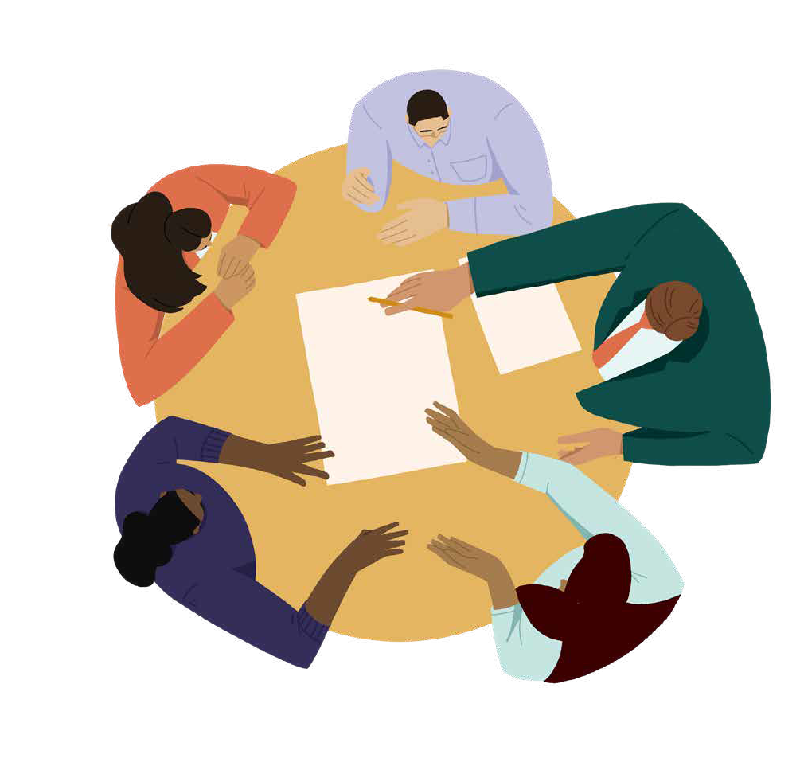
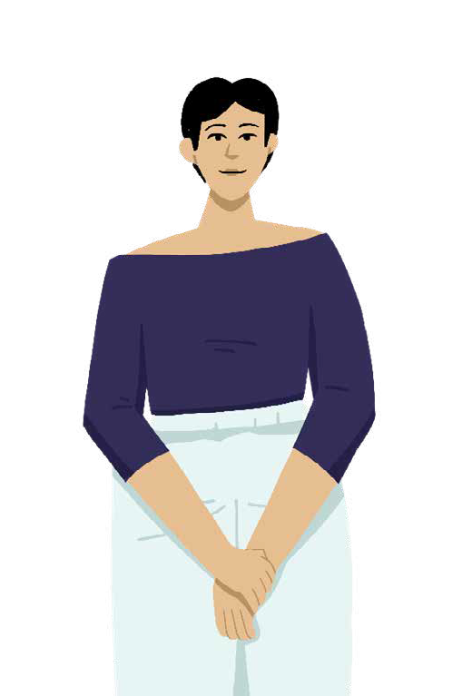
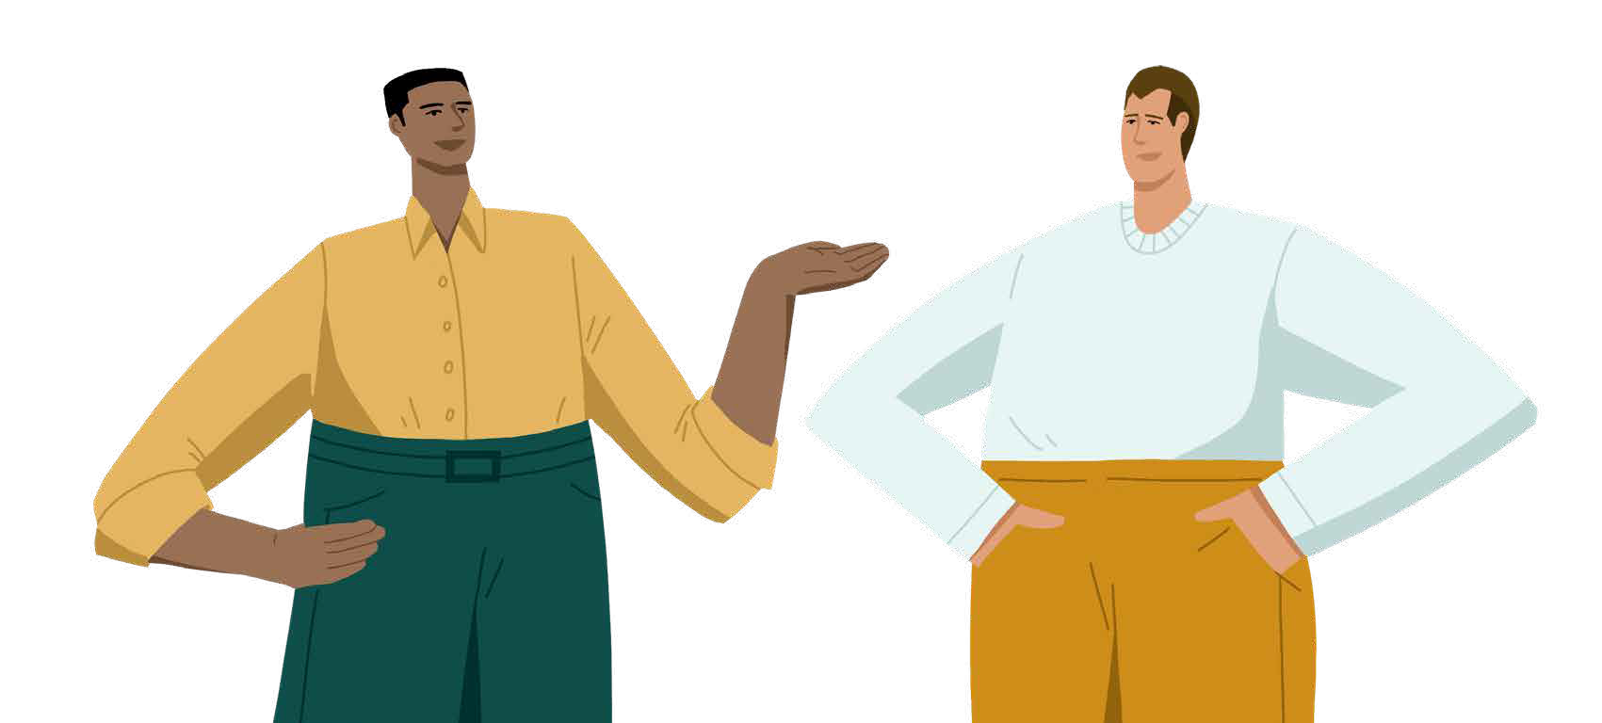
ALLYSHIP ACTIONS
Individual
Interpersonal
Structural
Share your pronouns
Use inclusive language
Observe group dynamics
Challenge your bias
Reduce interruptions
Give credit
Invite more voices
Ask for input
Distribute speaking time
Ensure meeting environments are accessible
Create systems to distribute “office housework”
©2021 LeanIn.Org, LLC 39
Notes:
In the Allyship at Work program, there are five overarching strategies for practicing allyship, and a number of specific actions to take under each strategy that we aren’t able to cover today.
As we heard in the video, there are three types of allyship actions we can take – individual, interpersonal, and structural. Here are just a few actions you can take to practice allyship that I want to leave you with today.
[Read slide]

Slide 40
Identify inequities at work
Active Allyship
Framework
See your privilege
NEXT STEP:
Consider actions to take
Consider actions to take
Own your positional power
©2021 LeanIn.Org, LLC 40
Notes:
The practice of allyship doesn't stop after today. This session only scratched the surface of ways to show up as allies—and we invite you to continue your journey with the full program which goes over 50 specific allyship actions.
As we now know, there are many ways to practice allyship depending on what privileges you have to leverage, what the problems or inequities are, what power or opportunities you have, and what action you want to take.
The Active Allyship Framework is meant to help you connect the dots between these pieces - to think about how to best use your privilege and power to address inequities (or in other words, how to practice allyship).
The framework is not linear - you don’t have to use it in any particular order - and you don’t need to formally run through it before acting as an ally. But it can be a helpful tool for planning or reflection along your allyship journey. The full program expands on this and provides even more allyship actions you can take.

Slide 41
Wrap up
©2021 LeanIn.Org, LLC 41
Notes:
Let’s review what we covered today to wrap up the workshop.
First, we defined allyship.
We learned that allyship is an active and consistent effort to use your privilege and power to support and advocate for people with less privilege.
Then, we unpacked our privilege and understood workplace inequities.
We examined our own privilege, inside and outside of the workplace and explored systemic inequities that hold people back at work.
Then we learned that power is our ability to make an impact at work - and that our positional power is the power we have that’s based on our role and level.
Lastly, we explored a short list of allyship actions we can take.

Slide 42
ONE COMMITMENT
What is One Commitment you want to leave with today?
This a commitment you make to yourself and the group on how you will practice allyship in the next 30 days.
©2021 LeanIn.Org, LLC 42
Notes:
We’re going to close out the Introduction to Allyship at Work by making One Commitment for something we’ll do to continue our allyship journey in the next 30 days
I will give you 1 minute to journal about what your One Commitment is:
That might mean practicing an action you learned about today.
It could also mean talking to someone else in the workshop about allyship to continue your journey together.
Once you’ve written it down, I welcome you to share it in the chat.
[Set timer for 1 minute]
Now, I’d like to invite a couple of people to share their One Commitment out loud with the group.
[Encourage participants to share aloud. If no one feels comfortable, read a few commitments from the chat aloud]
Thank you for sharing your One Commitments.

Slide 43
Resources to continue your allyship journey….
Experience the full program! Sign up for a Lean In hosted Allyship at Work Half-Day Workshop at leanin.org/events
Visit leanin.org/allsyhip for additional program resources
For questions specific to Allyship at Work you can reach out to allyship@leanin.org
©2021 LeanIn.Org, LLC 43
Notes:
Before you leave, there are a few more resources you can use to continue your allyship journey that I’ll share in the chat.
You can Sign up for the full workshop at leanin.org/events
Visit leanin.org/allyship or additional program resources
And, for questions you’d like to connect the Lean In team about, email allyship@leanin.org.
[Share the resources in the chat]

Slide 44
THANKS FOR PARTICIPATING IN TODAY’S WORKSHOP
©2021 LeanIn.Org, LLC 44
Notes:
Thank you for taking the time to be in this workshop with us. We’re so grateful that you all chose to be here today – so much of allyship, as we hope you’ve learned, is about showing up and actually doing the work, including learning the foundation and what actions you can take.
[MODERATOR PERSONALIZATIONS: As you close out the workshop, this is a great place to customize and share your thoughts on how you will carry this program forward within your organization or provide any closing advice for the group.]

